Slide 1
Using Docker
For Development and Production
Notes:
Yep, notes are showing:)

Slide 2
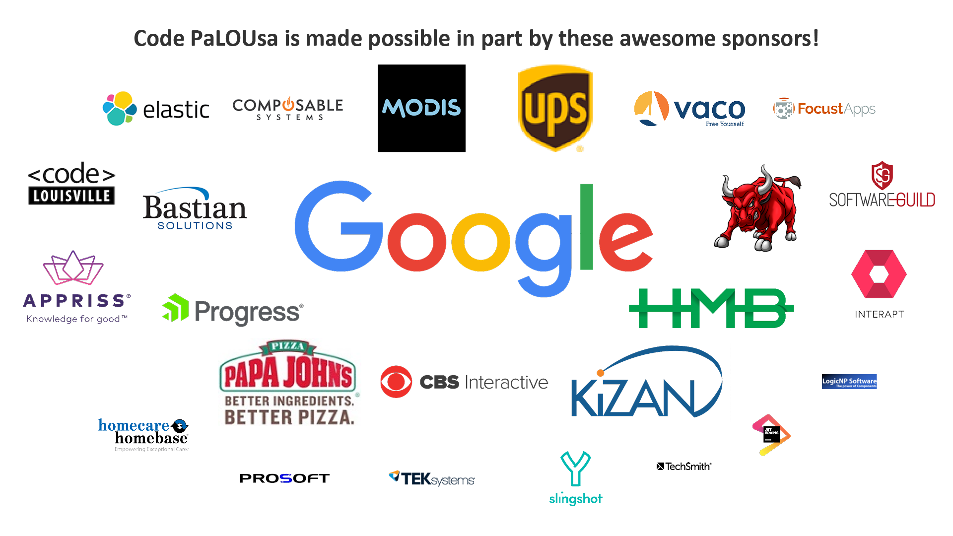

Slide 3

Clayton Hunt
Meetup: Co-founder St.Pete .Net Meetup
Blogs: 6figureDev.com,
ProgrammingFromScratch.com
Twitter: @ClaytonHunt_104
Author: Practical Test-Driven Development using C# 7

Slide 4
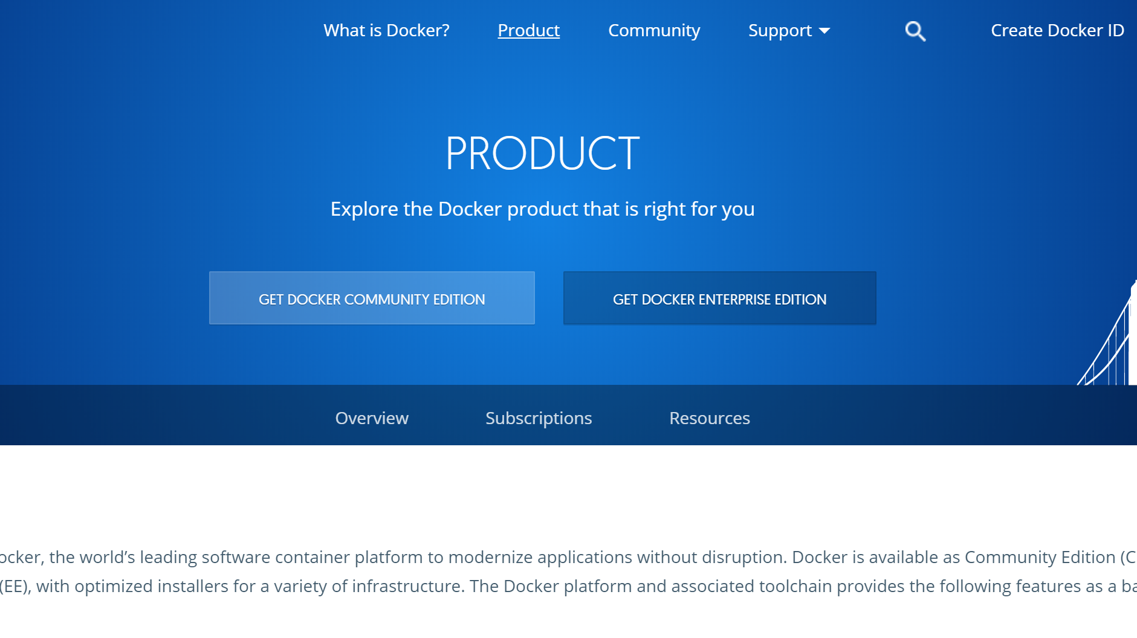
Get Docker
https://www.docker.com/get-docker

Slide 5
To the Code
Debug?, Test, Deploy

Slide 6
Get The Code
https://github.com/ClaytonHunt/UsingDockerForDevAndProd

Slide 7
Clayton Hunt
Meetup: Co-founder St.Pete .Net Meetup
Blogs: 6figureDev.com,
ProgrammingFromScratch.com
Twitter: @ClaytonHunt_104
Author: Practical Test-Driven Development using C# 7

